Slide 1
CAPEX – CAPital EXpenditures :
Definition – Budget – Profitability – Approval – Follow-up
Alliance Centre Brabant Wallon Author : Jean Hardy
Axis Parc, Business Center jean.hardy@jhfinaglass.eu
B 1435 - Mont-Saint-Guibert ( Belgium ) Layout : Elisabeth Bast
Notes:
This template can be used as a starter file to give updates for project milestones.
Sections
Right-click on a slide to add sections. Sections can help to organize your slides or facilitate collaboration between multiple authors.
Notes
Use the Notes section for delivery notes or to provide additional details for the audience. View these notes in Presentation View during your presentation.
Keep in mind the font size (important for accessibility, visibility, videotaping, and online production)
Coordinated colors
Pay particular attention to the graphs, charts, and text boxes.
Consider that attendees will print in black and white or grayscale. Run a test print to make sure your colors work when printed in pure black and white and grayscale.
Graphics, tables, and graphs
Keep it simple: If possible, use consistent, non-distracting styles and colors.
Label all graphs and tables.

Slide 2
CAPEX – CAPital EXpenditures :
Definition – Budget – Profitability – Approval – Follow-up
Definition
Budget
Profitability
  Small projects : SPB = Simple Pay-Back
  Big projects : DCF = Discounted Cash-Flow
  DPB = Discounted Pay-Back
  NPV = Net Present Value
  IRR = Internal Rate of Return
Approval
Follow-up
Notes:
What is the project about?
Define the goal of this project
Is it similar to projects in the past or is it a new effort?
Define the scope of this project
Is it an independent project or is it related to other projects?
* Note that this slide is not necessary for weekly status meetings

Slide 3
1. Definition
Today expenses, generating future profits
+ €
Decision
Profits
Time
- €
Expenses
Notes:
What is the project about?
Define the goal of this project
Is it similar to projects in the past or is it a new effort?
Define the scope of this project
Is it an independent project or is it related to other projects?
* Note that this slide is not necessary for weekly status meetings

Slide 4
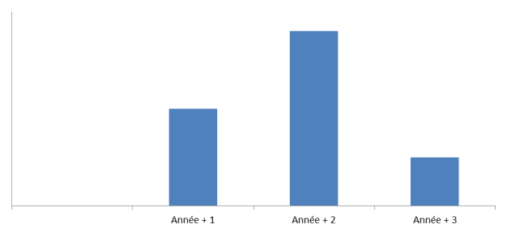
2. Budget
CAPEX are included in yearly budget process
+ €
3 years Plan
Validation
time
Yearly total
  « Big projects » : to be isolated, one by one
  Zoom on ( Year + 1 ), including « delegated capital »
Two different concepts :
  Year of Approval ( for engineering managers ! )
  Year(s) of Expenses ( for financial managers ! )
Notes:
What is the project about?
Define the goal of this project
Is it similar to projects in the past or is it a new effort?
Define the scope of this project
Is it an independent project or is it related to other projects?
* Note that this slide is not necessary for weekly status meetings

Slide 5
3. Profitability a) Small projets : SPB = Simple Pay-Back
SPB = 1.000 € . = 2 years
500 €/year
Notes:
What is the project about?
Define the goal of this project
Is it similar to projects in the past or is it a new effort?
Define the scope of this project
Is it an independent project or is it related to other projects?
* Note that this slide is not necessary for weekly status meetings

Slide 6
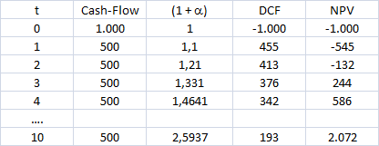
3. Profitability ( next ) b) Big projects : DCF, DPB, NPV and IRR
« Discount Rate » ( α = i + r ) is taken into account
    i = interest ( since a few years : close to zero ! )
    r = risk exposure ( depending of each specific market )
    DCF = Discounted Cash-Flow = Cash-Flow (t) / (1 + α)^{t}
Let’s assume α = 10 %
Notes:
What is the project about?
Define the goal of this project
Is it similar to projects in the past or is it a new effort?
Define the scope of this project
Is it an independent project or is it related to other projects?
* Note that this slide is not necessary for weekly status meetings

Slide 7
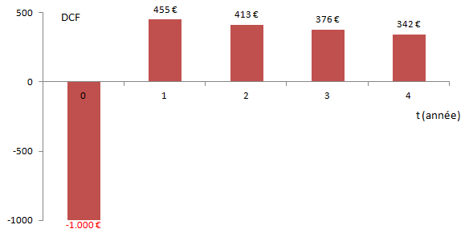
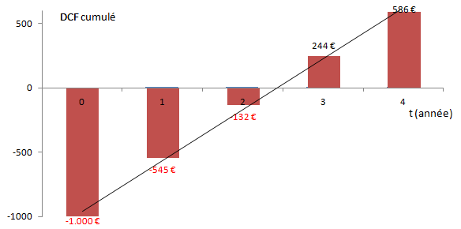
3. Profitability ( next )
b) Big projects : DCF, DPB, NPV and IRR ( next )
DPB = Discounted Pay-Back = where cumulated DCF crosses t-Axis !
Between 2 and 3 years. More precisely : 2 + 132 . = 2,36 years
(132 + 244)
Notes:
What is the project about?
Define the goal of this project
Is it similar to projects in the past or is it a new effort?
Define the scope of this project
Is it an independent project or is it related to other projects?
* Note that this slide is not necessary for weekly status meetings

Slide 8

3. Profitability ( end )
b) Big projects : DFC, DPB, NPV and IRR ( end )
NPV = Net Present Value = Cumulated DCF, on the horizon T fixed
Let’s assume T = 10 years. NPV = 2.072
If NPV < 0 :
IRR = Internal Rate of Return
Coefficient β, verifying Σ CF(t) / (1 + β)^{t} = 0
With previous assumptions : IRR = 49 %
Financial people like IRR, but :
    Not easy to “feel” the result
      ( IRR = 49 % … what does it mean? )
    Not easy to solve the mathematic formula
      ( PC and pocket calculators use iteration method )
Notes:
What is the project about?
Define the goal of this project
Is it similar to projects in the past or is it a new effort?
Define the scope of this project
Is it an independent project or is it related to other projects?
* Note that this slide is not necessary for weekly status meetings

Slide 9
4. Approval process
a) Who is responsible for what ?
Three main actors … not to confuse their respective roles !
The « Sponsor »
  Initiates the process
  Prepare the CAPEX file, with support of experts, if needed
The « Capex Administrator »
  Checks if the file is complete
  Checks coherence with strategy and with budget
  NOK ? Sends back the file to the Sponsor, for correction
  OK ? Green light for approval process
The « Approvers »
  Check and validate main assumptions ( commercial, industriel, financial )
  NOK ? Send back the file to the Sponsor, for correction
  OK ? Approval of the file
Notes:
What is the project about?
Define the goal of this project
Is it similar to projects in the past or is it a new effort?
Define the scope of this project
Is it an independent project or is it related to other projects?
* Note that this slide is not necessary for weekly status meetings

Slide 10
4. Approval process ( next )
b) Typical content of an approval file
Standard form ( see page 11 )
Mandatory documentation ( see page 14 )
Optional appendices ( see page 17 )

Slide 11
4. Approval process ( next )
c) Standard form
Within one page A4, it must specify:
Correct title of the project and its localisation
Key milestones of planning
Key data
Main financial data
Short description of the project, with main targets
SWOT analysis
Main KPI (« Key Performance Indicators »),
no more than 3, but always with numerical values !
See next page.

Slide 12
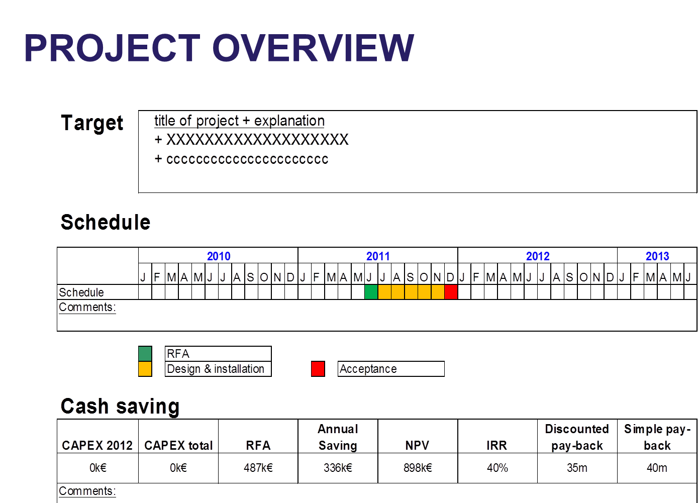
4. Approval process ( next )
c) Standard form ( next )

Slide 13
4. Approval processus ( next )
d) Mandatory documentation
« HSE » ( Health, Safety, Environment ) check-list
  Health ? Dust, noise, radiations, temperatures, dangerous products, …
  Safety ? Individual and collective protection, fire protection, ergonomics, …
  Environment ? Legal authorizations : air, water, waste, pollution, energy consumption, …
Profitability analysis
  Small projects ( threshold to be defined ) : simple « pay-back »
  Big projects : standard Excel model to be used
    DPB = « Discounted Pay-Back »
    NPV = « Net Present Value »
    IRR = « Internal Rate of Return »
  See example on 2 next pages
Powerpoint Presentation for big projects
( no more than 15 pages ! )

Slide 16
4. Approval process ( next )
e) Optional appendices
Detailed drawings
Call for request, received quotations, …
Third-party recommandations ( authorities, …)

Slide 17
5. Follow-up
a) For big projects : “Post Audit”
+/- 1 year after completion of the project
Check if targets and KPI have been reached
Check if budget and planning have been respected
Learn from them for the future ( communication )

Slide 18
5. Follow-up ( end )
b) What about extra expenses ?
Key issue : to check the costs from an accounting
point of view
Responsible : the Capex Administrator
If overtaking ≥ 10 % ( threshold to be defined ) :
to launch a new approval process, with reviewed amount

